Slide 1
Hotel Reservation System
TS- WEB/CC/AI TRACK CAPSTONE PROJECT
Presented By:
1. Miss Junnuthula Divya-Avanthi institute of engineering(B.Tech CSE)
2. Miss G.Gayathri -Avanthi institute of engineering(B.Tech CSE)
3. Miss Thangella Jahnavi-Avanthi institute of engineering(B.Tech CSE)
4. Miss Gurram Manasa-Avanthi institute of engineering(B.Tech CSE)
Guided By:Uma Maheswari

Slide 2
OUTLINE
Abstract
Problem Statement (Should not include solution)
Aims , Objective & Proposed System/Solution
System Design
System Development Approach(Technology Used)
Algorithm & Deployment
Conclusion
References
Future Scope

Slide 3
Abstract
A Hotel Reservation System is the mechanism through which the guests can create secure online reservation.
Through the hotel reservation system software, guests can choose how long they will stay, the type of room they want, get add-ons , and pay securely online through a payment platform.
Administrator can add/update the hotel and room information.
It can have a more secure and private records or files from customers.

Slide 4
Problem Statement
The hotel contains a number of hotel rooms available for hire to guests. The information relevant to each room is
Room Number
Basic price
Maximum occupancy
Type of Room(single,double,twin,executive,suit)

Slide 5
Proposed Solution
The proposed system is a web based application that allows customers to make enquiries online and book for services providing the required details.
A customers surfs through any of the items of the proposed system.
Customer can make reservations at their own place.
A contact us page is provided where customer can send emails.

Slide 6
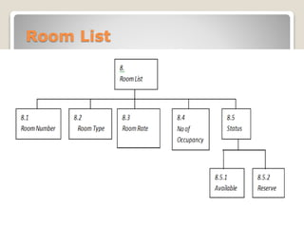
System Architecture

Slide 7
System Deployment Approach
Software Requirements:
Operating System : Windows Family or higher version
Technologies :Servlets,jsp,jdbc
Data Bases :Mysql
Hardware Requirements:
Processor :: Ryzon 5
Ram :: 64MB (or) Higher
Cache :: 512MB
Hard disk :: 10GB

Slide 8
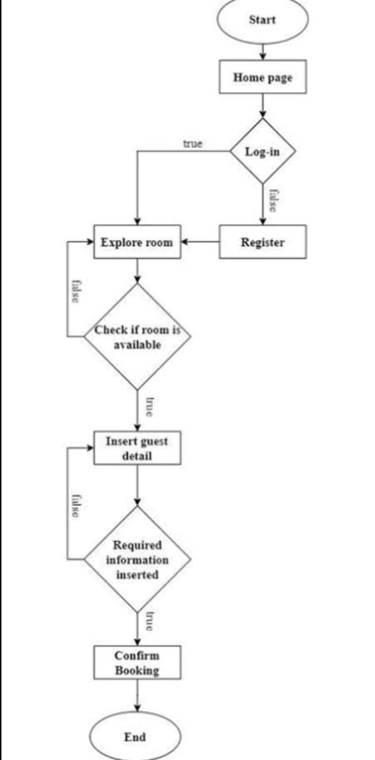
Algorithm & Deployment

Slide 9
THANK YOU

